Slide 1
PIP4004 University Project
Review-3
Blockchain- Enabled Online Certificate Generation and Validation Systems for Government Organizations
Batch Number:CSE-G199
NAMES | ROLL.NO
PRAKRUTHI S | 20211CSE0628
DEEPTHI R | 20211CSE0618
NIDHISHA N | 20211CSE0677
Under the Supervision of,
Dr. Anand Prakash
Associate Professor
School of Computer Science and Engineering
Presidency University
Name of the Program: CSE
Name of the HoD: Dr. Asif Mohammed H.B
Name of the Program Project Coordinator: Dr. Anand Prakash
Name of the School Project Coordinators: Dr. Abdul Khadar A

Slide 2
Introduction
Problem
Traditional digital certificate systems are vulnerable to fraud and data breaches.
Solution
Blockchain technology provides a decentralized, immutable, and transparent platform for managing credentials.
Benefits
Enhanced security and authenticity.
Simplified verification.
Automated issuance and management through smart contracts.
Empowerment to control and share their credentials.
Streamlined integration with online learning platforms.
Applications
Significant potential in education for managing academic credentials (eg.Courses).
Challenges
Scalability, regulatory compliance, and interoperability.
Outlook
Ongoing research and development are addressing these challenges.
.

Slide 3
Literature Review
Blockchain Fundamentals and Applications:
Blockchain technology underpins secure, decentralized certificate systems, ensuring immutability and transparency.
Consensus mechanisms like PoW and PoS influence efficiency and security, making them critical for government applications.
Security and Trust in Blockchain:
Blockchain resists attacks like 51% and Sybil attacks, ensuring trust-less cryptographic transactions for certificate-validation.
Key management, identity security, and smart contract vulnerabilities must be addressed for robust certificate management.
Certificate Systems for Government Organisations:
Blockchain enhances security, efficiency, and fraud prevention in certificate issuance and verification.
Government adoption faces challenges like interoperability, legal compliance, and integration with existing systems.

Slide 4
Literature Review
Legal and Regulatory Aspects:
Legal challenges arise due to blockchain's immutability conflicting with privacy laws like GDPR.
Standardisation efforts are essential to ensure seamless global adoption of blockchain-based certificate systems.
Future Trends and Research Directions:
Enhancing interoperability among blockchain networks is vital for global certificate verification.
Research into privacy-preserving models and AI integration will improve security and efficiency in verification.

Slide 5
Existing method Drawback
Traditional Paper-Based Certificates:
Government institutions issue printed certificates with official seals, widely accepted and requiring no digital infrastructure.
However, they are prone to forgery, loss, high administrative costs, slow verification, and require physical storage.
Centralised Traditional Systems:
Certificates are stored in government or institutional databases, enabling controlled issuance and validation.
They face risks of a single point of failure, slow verification, high operational costs, and limited transparency.

Slide 6
Existing method Drawback
Hybrid Blockchain Systems
Merges blockchain security with centralised databases for improved efficiency and scalability.
Adds complexity in data synchronisation, potential inconsistencies, and partial decentralization benefits.
Smart Contract-Based Validation
Automates certificate verification, reducing human error and eliminating third-party dependencies.
However, smart contracts are complex to write, difficult to modify, and vulnerable to bugs and security exploits.
Blockchain and Digital Identity Integration
Links certificates to verified digital identities, ensuring secure and seamless validation across platforms.
Raises concerns about privacy, legal regulations (e.g., GDPR compliance), and high infrastructure costs.

Slide 7
Proposed Method
User Authentication Module (Flask & MySQL)
User login & registration using Flask-Login.
Stores user credentials in MySQL (passwords hashed with Flask-Bcrypt).
Session management for authentication.
Blockchain Implementation Module (Python Blockchain)
Implements a custom blockchain to store certificate hashes.
Supports block creation & mining to ensure data integrity.
Provides functions to add and validate certificate hashes.
Smart Contract Module (Ethereum & Solidity)
Defines certificate issuance & verification logic.
Uses Ethereum blockchain to store certificate hashes.
Emits events (CertificateIssued, CertificateVerified).
Accessed using Web3.py in Python.

Slide 8
Proposed Method
Certificate Management Module
Users upload certificates.
Converts the certificate into a SHA-256 hash.
Sends the hash to the blockchain for permanent storage.
Web Interface (Flask App)
Templates (HTML templates for UI)
Static (CSS & JavaScript files)
Provides a dashboard for users.
Users can upload & verify certificates.
Database Module (MySQL)
Stores user details
Manages metadata of certificates issued.

Slide 9
Objectives
Enhanced Security
Secure and tamper-proof system for generating and storing digital certificates
Eliminating the risk of forgery, alteration, and unauthorised access.
Increased Transparency
Transparent record of all certificate transactions
Enabling easy verification.
Simplified Verification
Streamline the certificate verification a fast process
Efficient
Accessible to public without the need for intermediaries.
Automation and Efficiency
Automate the certificate issuance and management process through smart contracts
Reducing administrative overhead, human error and associated costs.
Improved Trust and Credibility
Trust and credibility in digital certificates
Authenticity and Verifiability,

Slide 10
Objectives
Empowerment of Individuals
Greater control over digital credentials
Can easily manage, share, and validate achievements.
Interoperability
Interoperability between different blockchain platforms and existing systems
Facilitating seamless exchange.
Scalability
Handles large volume of certificate transactions efficiently and effectively.
Regulatory Compliance
Data protection regulations.
Accessibility and User-Friendliness
User-friendly system for both certificate issuers and recipients
Simplifies the process of generating, managing, and verifying credentials.

Slide 11
Methodology/Modules
This system ensures a secure, efficient, and immutable blockchain-based certificate generation and
verification process. It consists of the following key modules:
1. User Authentication:
The user logs in using credentials (username and password).
2. Certificate Generation:
The system retrieves recipient details (name, degree, course, issue date, etc.) from a secure database.
A digital certificate is generated with the extracted details and formatted into a structured template.
3. Security Encoding:
The certificate undergoes encryption or hashing using cryptographic techniques to prevent tampering.
A digital signature is applied to validate the authenticity of the certificate and the issuing authority.

Slide 12
Methodology/Modules
4. Blockchain Integration:
The system uses a public or permission blockchain (e.g., Ganache) to store certificate details.
A smart contract is deployed to automate certificate issuance and validation.
5. Certificate Storage & Access:
The encoded certificate and unique cryptographic key are stored securely in a database.
Users can download or share their certificates through a web-based portal or mobile application.
6. Verification Process:
Users can verify a certificate through the generated hash tag.
The system extracts the cryptographic key from the blockchain and verifies the certificate data.
7. Data Security & Privacy:
Sensitive user data is protected using encryption, ensuring security at rest and in transit.
Role-Based Access Control restricts access to authorized personnel (e.g., administrators, certificate holders).

Slide 13
Methodology/Modules
8. System Integration & Compliance:
APIs enable seamless integration with government databases, educational institutions, and third-party verifiers.
The system is designed to comply with legal frameworks, ensuring trust and legitimacy of issued certificates.
9. User Interface & Accessibility:
A web portal ,mobile-friendly application allow users to request, download, and verify certificates with ease.
The system is designed to be intuitive, requiring minimal technical knowledge for users.
10. Monitoring & Performance Evaluation:
The system undergoes regular audits and vulnerability scans to identify and mitigate security risks.
Performance metrics (e.g., certificate issuance speed, verification response time, user satisfaction) are monitored.
This enhanced methodology provides a comprehensive and structured approach to implementing a Blockchain
Based Certificate Generation and Validation System, ensuring security, efficiency, and reliability.

Slide 14
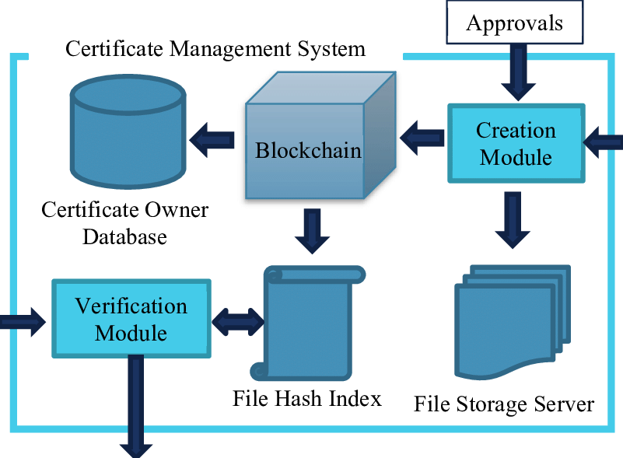
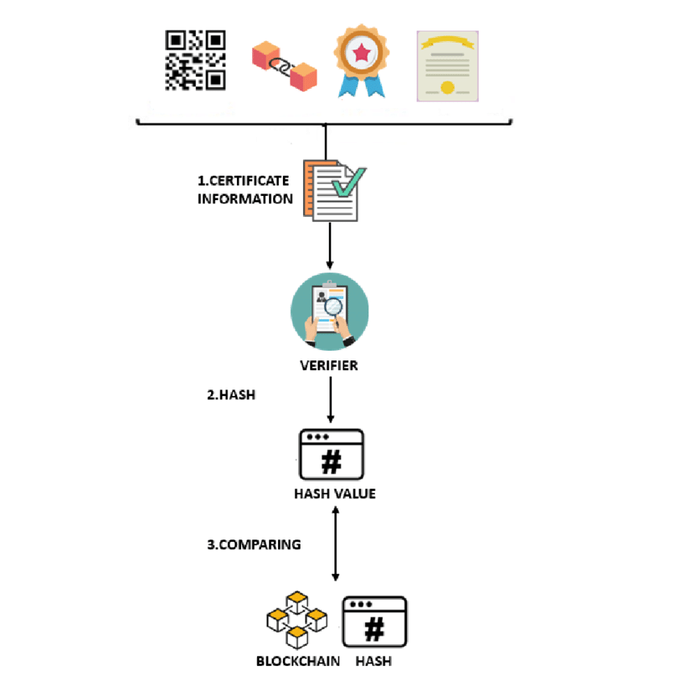
Architecture

Slide 15
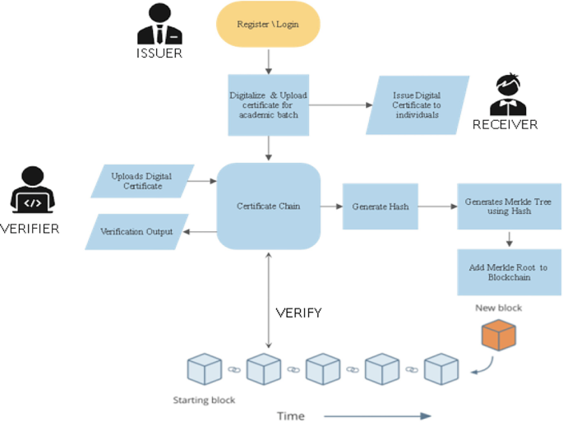
Architecture

Slide 16
Software Components
Flask (Python Framework)
Manages the web interface for certificate generation and verification.
Blockchain (Ethereum - Smart Contracts)
Ensures certificate authenticity by storing unique certificate hashes on Ethereum.
Solidity (Smart Contracts)
Defines rules for issuing and verifying certificates.
Web3.py (Ethereum Interaction)
Connects the backend with the Ethereum blockchain to interact with smart contracts.
SHA-256 Hashing (Digital Signature)
Generates a cryptographic hash for each certificate to prevent forgery.
FPDF (PDF Generation)
Creates and formats the final certificate PDF, including authorized signatures and official seals.

Slide 17
Software Components
HTML + CSS (Frontend)
Designs the user interface for easy certificate generation and validation.
Ganache (Local Blockchain Simulator)
Provides a test blockchain environment for deploying and testing smart contracts without using real ETH.

Slide 18
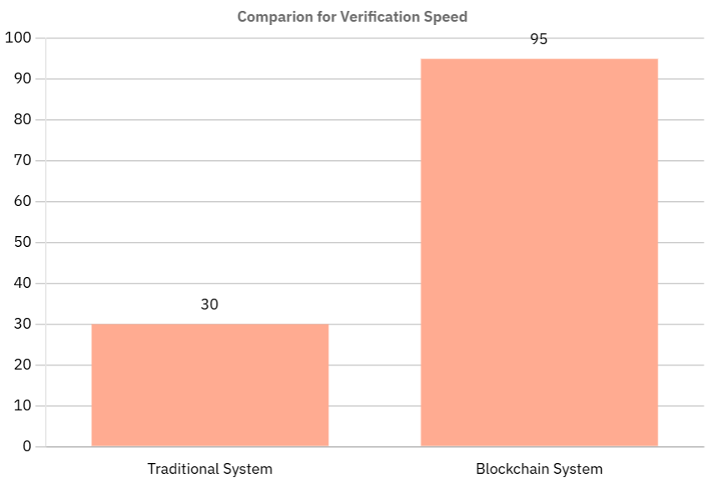
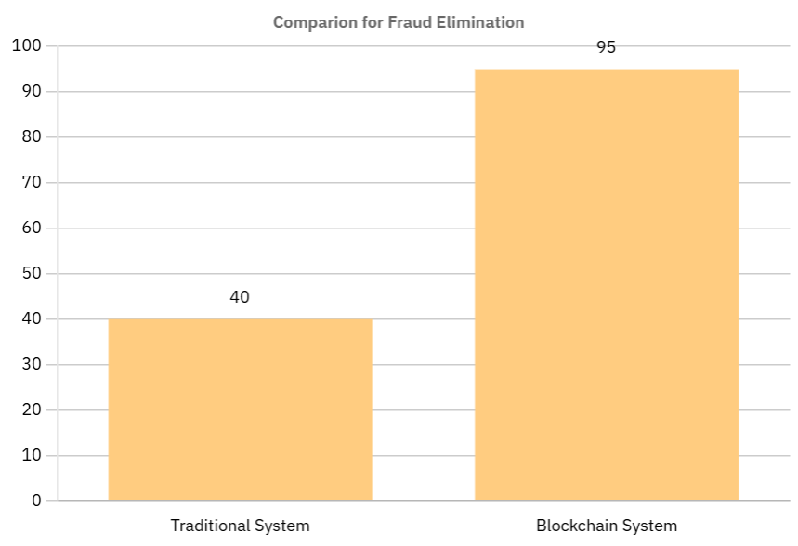
Expected Outcomes
1. No Fake Certificates:
The system blocks the flow of counterfeit academic and professional certificates by making all credentials registered on an immutable blockchain.
Efficiency Score: Traditional - 40, Blockchain– 95
2. Quick Verification
Certificates can be checked in real-time using blockchain, reducing the necessity of manual checks by institutions and employers.
Efficiency Score: Conventional - 30, Blockchain – 95

Slide 19
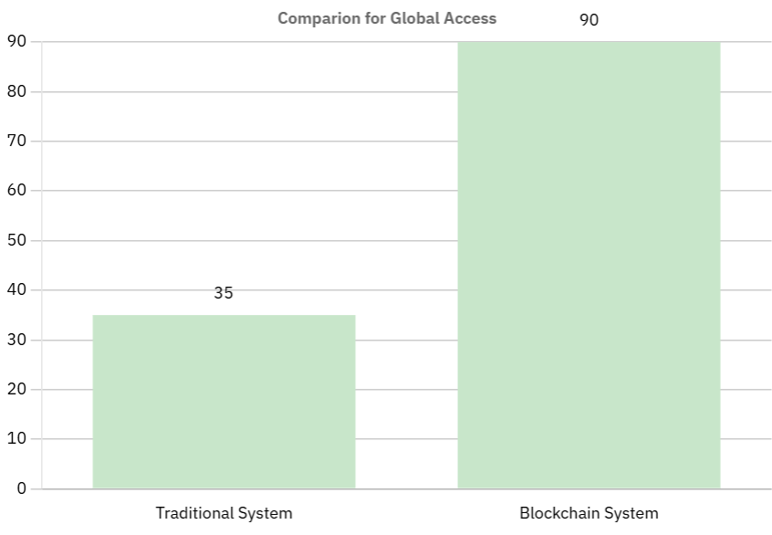
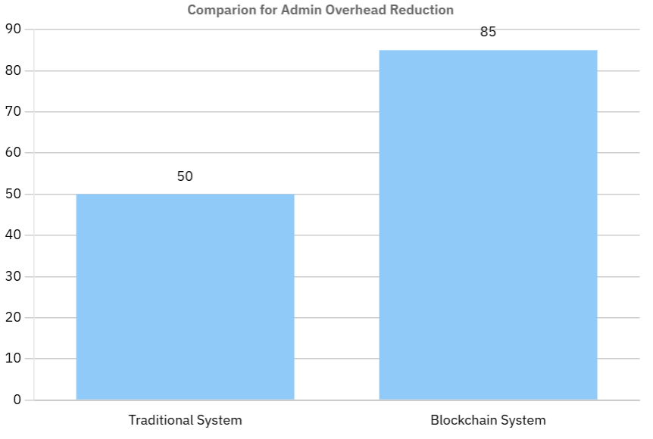
Expected Outcomes
3. Accessible Worldwide
Digital certificates on a decentralized network can be accessed and validated from anywhere
Efficiency Score: Conventional - 35, Blockchain– 90
4. Less Paperwork
Schools minimize paperwork and requests for verification
Efficiency Score: Traditional - 50, Blockchain– 85

Slide 20
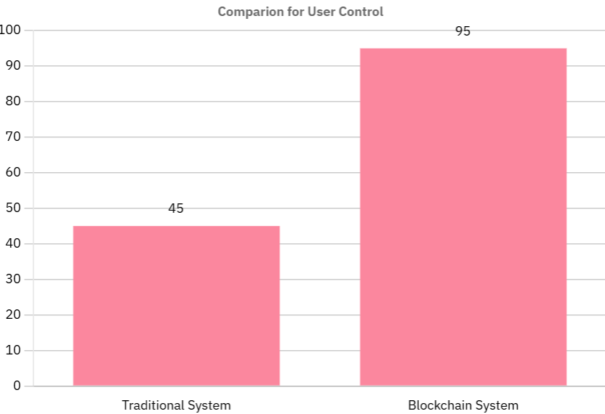
Expected Outcomes
5. User Ownership
Certificate holders have direct and enduring access to their credentials
Efficiency Score: Traditional - 45, Blockchain– 95

Slide 21
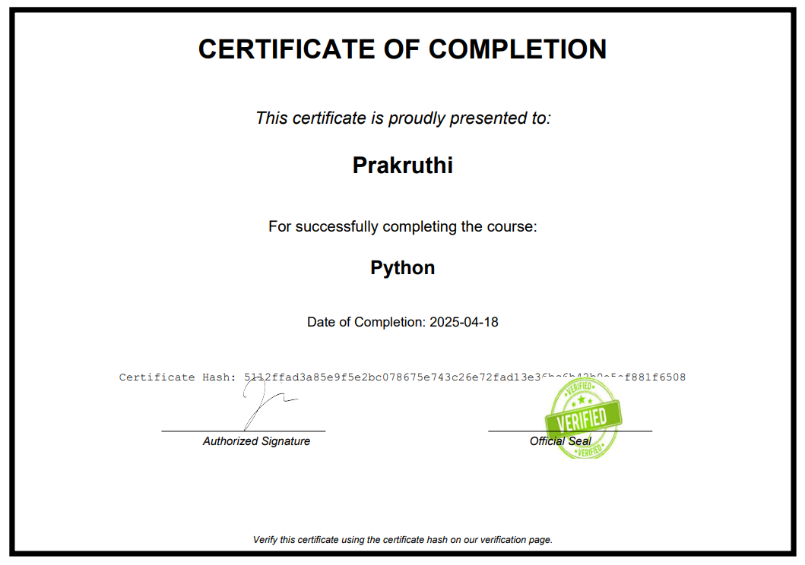
Screenshots

Slide 22
Conclusion
Problem
Traditional systems suffer from vulnerabilities like tampering, forgery, and security breaches
Trust issues and high administrative costs.
Solution
Blockchain technology offers a secure, transparent, and decentralized alternative.
Key Features
Immutability and transparency to prevent fraud.
Decentralization for enhanced security.
Simplified and efficient verification.
Automation through smart contracts.

Slide 23
Conclusion
​​Applications
Particularly beneficial in education for managing academic credentials.
Challenges
Scalability, interoperability
Outlook
Ongoing research and development are addressing challenges.

Slide 24
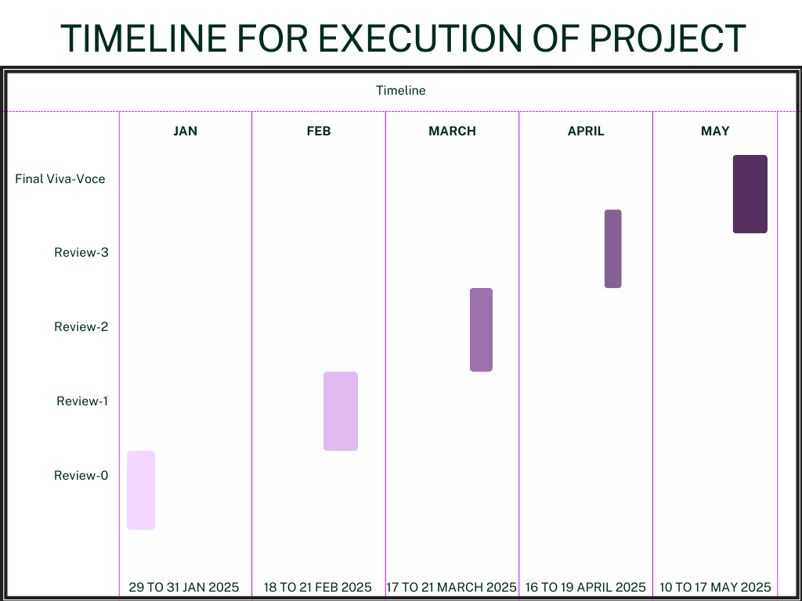
Timeline of Project

Slide 25
Github Link
https://github.com/Prakruthi27441/Project_S8.git

Slide 26
References
[1] A. A. Monrat, O. Schelén, and K. Andersson, "A Survey of Blockchain from the Perspectives of Applications Challenges and Opportunities,"IEEE Access, vol. 7, pp. 117134-117151, 2019.
[2] R. Ma, J. Gorzny, E. Zulkoski, K. Bak, and O. V. Mack, Fundamentals of Smart Contract Security. Berkeley, CA, USA: O’Reilly Media, 2021.
[3] H. E. Poston, Blockchain Security from the Bottom Up: Securing and Preventing Attacks on Cryptocurrencies, Decentralized Applications, NFTs, and Smart Contracts. Hoboken, NJ, USA: Wiley, 2023.
[4] D. Chanakal, D. Sachitra, H. Chandru, W. Chamin, G. Dias, and S. Fernado, "IDStack the common protocol for document verification built on digital signatures," in IEEE Xplore, 2017, pp. 8-12.
[5] D. S. V. Madala, M. P. Jhanwar, and A. Chattopadhyay, "Certificate Transparency Using Blockchain," in 2018 IEEE International Conference on Data Mining Workshops (ICDMW), 2018, pp. 71-80.
[6] H. R. Hasan et al., "Blockchain-Based Solution for COVID-19 Digital Medical Passports and Immunity Certificates," IEEE Access, vol. 8, pp. 222093-222108, Dec. 2020.
[7] IET Information Security, Institution of Engineering and Technology (IET).
[8] J. Cheng, N. Lee, C. Chi, and Y. Chen, "Blockchain and smart contract for digital certificate," in 2018 IEEE International Conference on Applied System Invention (ICASI), 2018, pp. 1046-1051.
[9] Journal of Blockchain Research, International Press of Boston.
[10] Journal of Blockchain Technology (JBT), Institute of Electronics and Computer Engineering (IECE).

Slide 27
[11] Journal of Information Technology, SAGE Publications.
[12] Journal of Sports Industry & Blockchain Technology (JSIBT), NDP Publishing.
[13] L. de Camargo Silva, M. Samaniego, and R. Deters, "IoT and Blockchain for Smart Locks," in 2019 IEEE 10th Annual Information Technology Electronics and Mobile Communication Conference, 2019, pp. 0262-0269.
[14] M. A. Ferrag, M. Derdour, M. Mukherjee, A. Derhab, L. Maglaras, and H. Janicke, "Blockchain Technologies for the Internet of Things: Research Issues and Challenges," IEEE Internet of Things Journal, vol. 6, no. 2, pp. 2188-2204, Apr. 2019.
[15] M. J. M. Chowdhury, A. Colman, M. A. Kabir, J. Han, and P. Sarda, "Blockchain Versus Database: A Critical Analysis," in 2018 17th IEEE International Conference on Trust Security and Privacy in Computing and Communications/12th IEEE International Conference on Big Data Science and Engineering, 2018.
[16] P. Frauenthaler, M. Sigwart, C. Spanring, M. Sober, and S. Schulte, "ETH Relay: A Cost-efficient Relay for Ethereum-based Blockchains," in 2020 IEEE International Conference on Blockchain (Blockchain), 2020.
[17] Q. Liu, Q. Guan, X. Yang, H. Zhu, G. Green, and S. Yin, "Education-Industry Cooperative System Based on Blockchain," in 1st IEEE International Conference on Hot Information-Centric Networking, 2018, pp. 207-211.

Slide 28

Project work mapping with SDG

Slide 29
Thank You

